Slide 1
221013 랩세미나
에너지 AI 김소희

Slide 2
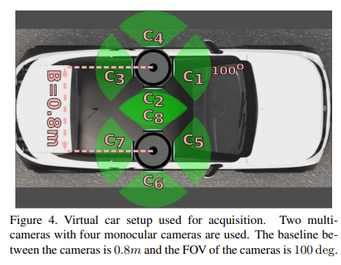
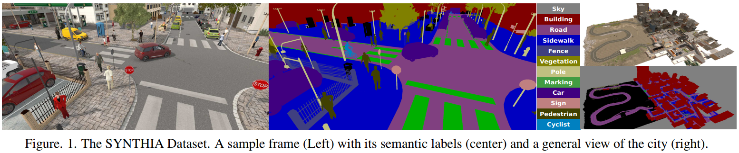
SYNTHIA (SYNTHetic Collection of Imagery and Annotations)
link
> CVPR 2016
The SYNTHIA dataset is a synthetic dataset that consists of 9400 multi-viewpoint photo-realistic frames rendered from a virtual city and comes with pixel-level semantic annotations for 13 classes (misc, sky, building, road, sidewalk, fence, vegetation, pole, car, sign, pedestrian, cyclist, lane-marking).
Each frame has resolution of 1280 × 960.
Scene diversity: European style town, modern city, highway and green areas
Variety of dynamic objects: cars, pedestrians and cyclists
Multiple seasons : winter, fall, spring, and summer
Light conditions and weather : dynamic lights and shadows, several day-time modes, rain mode and night mode
Automatic groundtruth : individual instances for semantic segmentation (pixelwise annotations), depth, car ego-motion
https://openaccess.thecvf.com/content_cvpr_2016/papers/Ros_The_SYNTHIA_Dataset_CVPR_2016_paper.pdf
Notes:
https://paperswithcode.com/dataset/synthia
Homepage : https://synthia-dataset.net/
Synthia-Rand-Cityscapes : a subset that contains 9, 400 images paired with Cityscapes, sharing 16 common classes

Slide 3
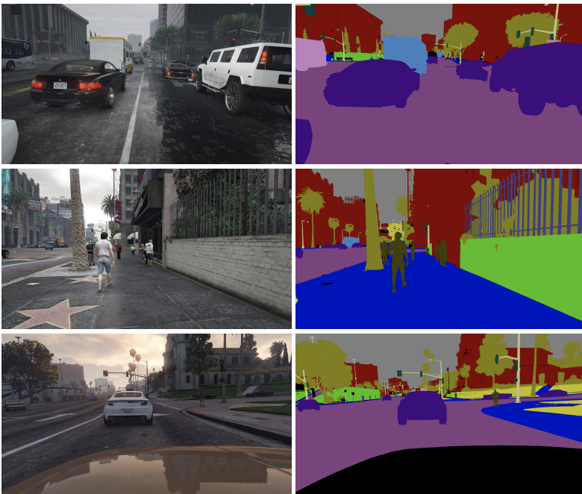
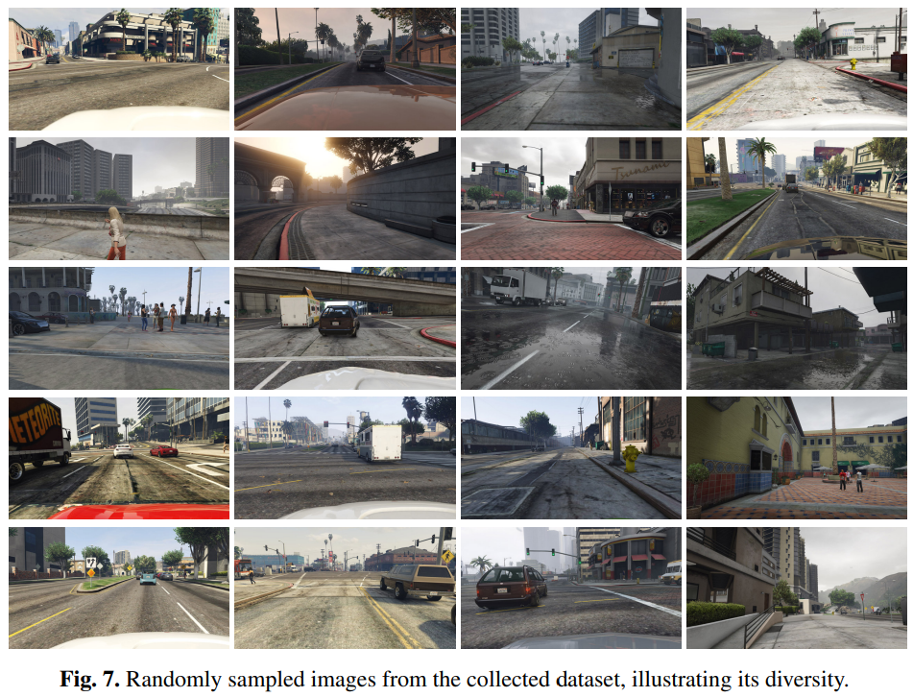
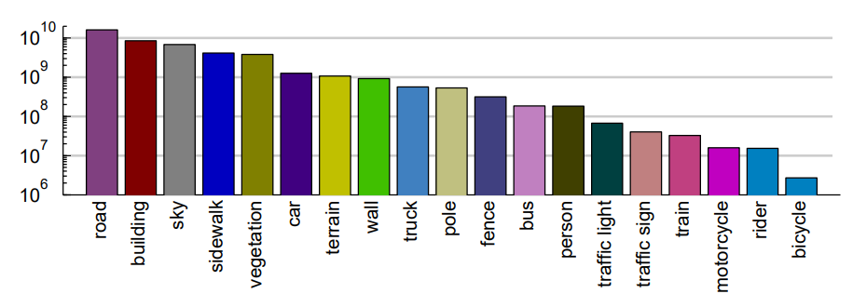
GTA5
link
> ECCV 2016
The GTA5 dataset contains 24,966 synthetic images with pixel level semantic annotation. The images have been rendered using the open-world video game Grand Theft Auto 5 and are all from the car perspective in the streets of American-style virtual cities. (urban scenery of Los Angeles city)
Each frame has a resolution of 1914×1052 pixels.
There are 19 semantic classes which are compatible with the ones of Cityscapes dataset.
GTA5
Semantic label maps
> Number of annotated pixels per class in dataset (color coding)
https://arxiv.org/pdf/1608.02192v1.pdf
Notes:
https://paperswithcode.com/dataset/gta5
Homepage : https://arxiv.org/pdf/1608.02192v1.pdf
To collect data, we used RenderDoc to record every 40th frame during GTA5 gameplay.

Slide 4
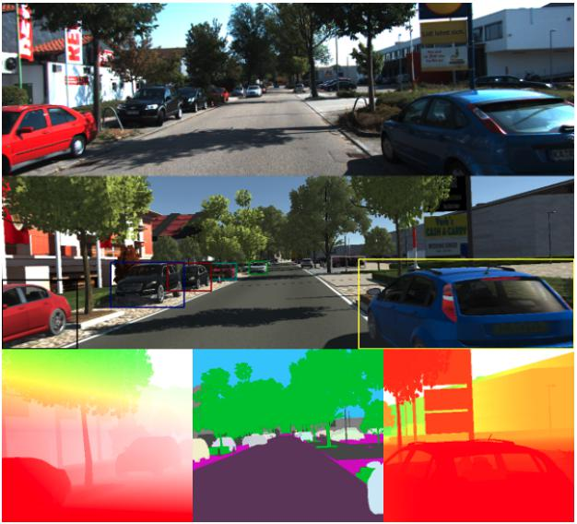
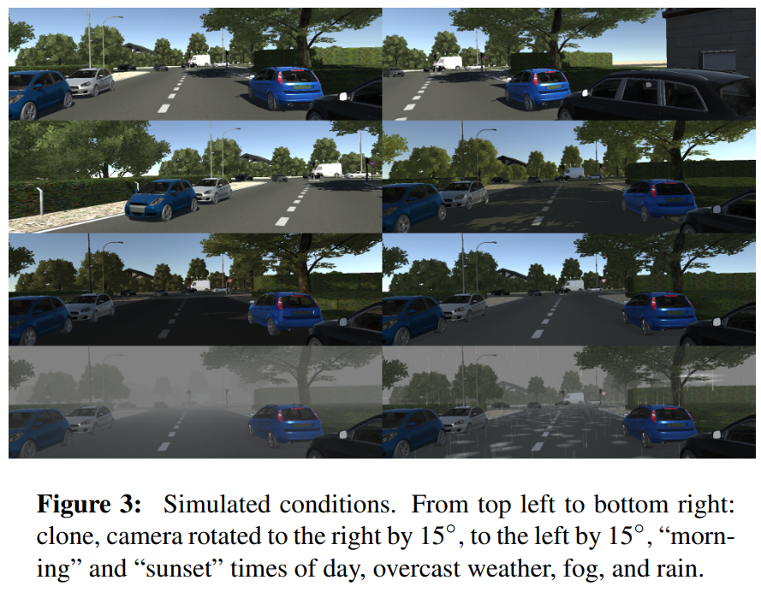
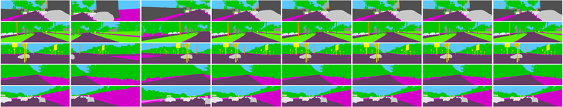
Virtual KITTI
link1, link2
> CVPR 2016
Virtual KITTI is a photo-realistic synthetic video dataset designed to learn and evaluate computer vision models for several video understanding tasks: object detection and multi-object tracking, scene-level and instance-level semantic segmentation, optical flow, and depth estimation.
Virtual KITTI contains 50 high-resolution monocular videos (21,260 frames) generated from five different virtual worlds in urban settings under different imaging and weather conditions.
KITTI
Each frame has resolution of around 1242 × 375.
14 Semantic category : Building, Car, GuardRail, Misc, Pole, Road, Sky, Terrain, TrafficLight, TrafficSign, Tree, Truck, Van, Vegetation
Virtual KITTI
> Semantic and Instance-level Segmentation GT
Segmentation
https://europe.naverlabs.com/research/computer-vision/proxy-virtual-worlds-vkitti-1/
https://arxiv.org/pdf/1605.06457.pdf
Notes:
https://paperswithcode.com/dataset/virtual-kitti
Homepage : https://europe.naverlabs.com/research/computer-vision/proxy-virtual-worlds-vkitti-1/
https://arxiv.org/pdf/1605.06457.pdf
Figure 1: Top: a frame of a video from the KITTI multi-object tracking benchmark [1]. Middle: the corresponding rendered frame of the synthetic clone from our Virtual KITTI dataset with automatic tracking ground truth bounding boxes. Bottom: automatically generated ground truth for optical flow (left), scene- and instance-level segmentation (middle), and depth (right).

Slide 5
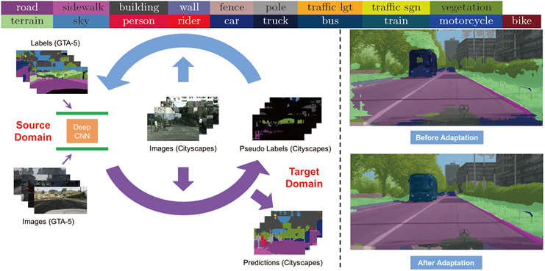
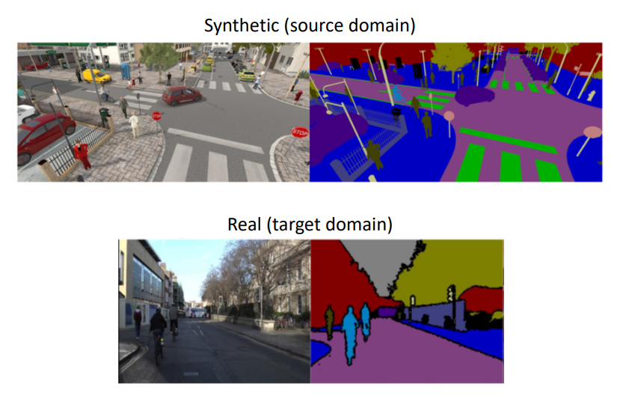
Domain Adaptation
도메인이 다르지만 관련이 있는 새로운 영역(distribution)에 기존 영역의 정보를 적응시키는 것.
Source dataset (가상 dataset) 으로 학습했던 모델이 target dataset (실제 dataset) 에서도 잘 적응하도록 함
Unsupervised Domain Adaptation (UDA) 종류
Adversarial training : target의 distribution이 source와 유사하도록 학습을 진행. (Source 쪽에서 학습한 feature들을 target domain condition으로 옮겨주겠다)
Generative network : target image를 source와 유사하게 만들어서 학습
Self-training : unlabeled data를 위해서 pseudo-labels 를 생성해서 학습하는 방법. 스스로 GT를 만들어서 기반으로 학습
Entropy minimization : ADVENT에서 사용한 방법
Synthetic Image Example for image segmentation ( ECCV 2020 Domain Adaptation for Visual Applications Tutorial part 1, 9 page)
Notes:
https://www.youtube.com/watch?v=eZeMOfXUbCM&t=1189s

Slide 6
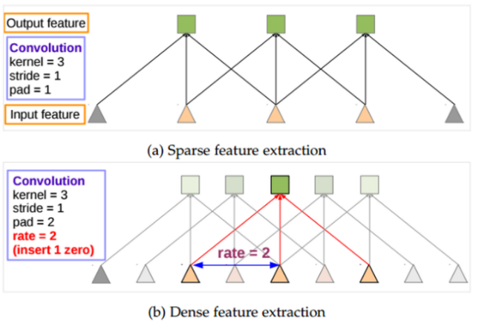
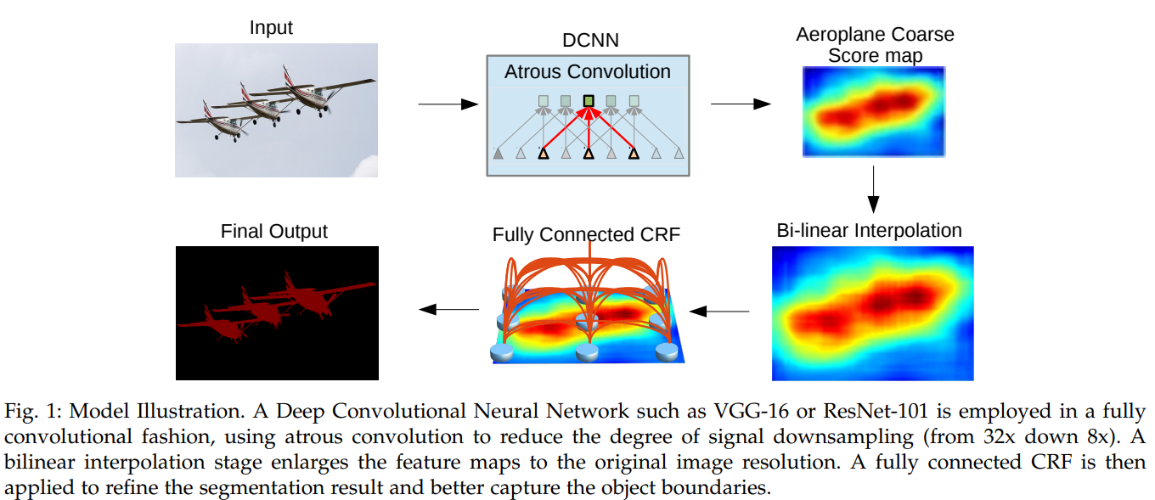
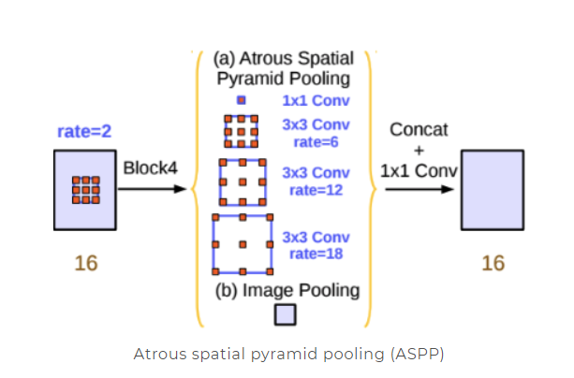
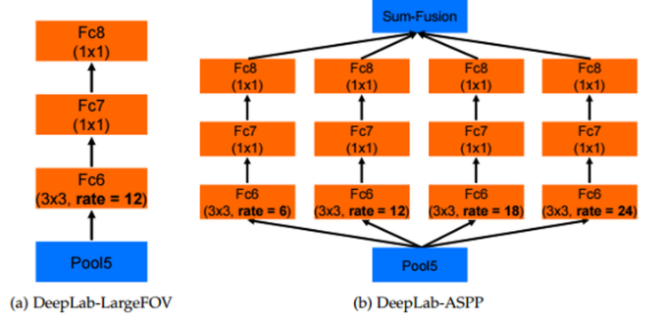
Domain adaptation에서 가장 많이 활용하는 semantic segmentation 네트워크
DeepLab-v2
> Atrous
Convolution
Multi-scale context를 적용하기 위한 Atrous Spatial Pyramid Pooling (ASPP)
DCNN을 통해 1/8 크기의 coarse score-map을 구하고,
이것을 bi-linear interpolation을 통해 원영상 크기로 확대를 시킨다.
Bilinear interpolation을 통해 얻어진 결과는 각 픽셀 위치에서의 label에 대한 확률이 되며 이것은 CRF의 unary term에 해당이 된다.
최종적으로 모든 픽셀 위치에서 pairwise term까지 고려한 CRF 후보정 작업을 해주면 최종적인 출력 결과를 얻을 수 있다.

Slide 7
Depth Learning
Unsupervised Monocular Depth Learning in Dynamic Scenes
Li, Hanhan, et al. arXiv preprint arXiv:2010.16404 (2020).

Slide 8
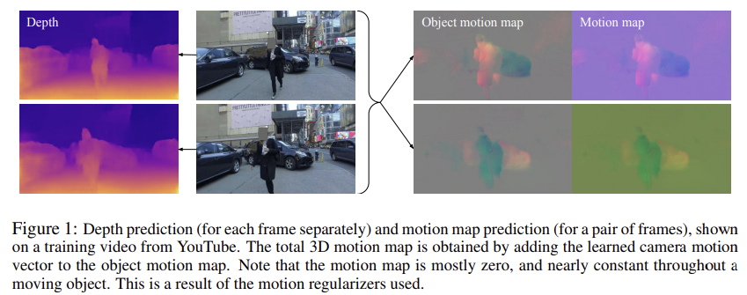
Li, Hanhan, et al. "Unsupervised monocular depth learning in dynamic scenes." arXiv preprint arXiv:2010.16404 (2020).
Introduction
⇒ A method for learning jointly depth, ego-motion and a dense object motion map in 3D from monocular only
Novel regularization method for the residual translation fields (based on 1/2 norm)
Depth map
Deep network → a dense 3D translation field
Background translation : camera (ego-motion)
Object translation field
Significant amount of regularization
Regularizing sufficiently(충분히)
Preserving the ability of model 모델의 능력 보존
Nature of residual translation fields
They are sparse 희소하다 – 대부분 background / static 물체
Tend to be constant 일정하다 – rigid moving object in 3D space
Notes:
Regularization – 가중치 규제
regularization을 하는 것, 즉 W가 작아지도록 학습을 한다는 것의 의미는 local noise가 학습에 큰 영향을 끼치지 않는다는 것을 의미하며, outlier(특이점)의 영향을 적게 받도록 하고 싶은 것이다. 결과적으로 일반화에 적합한 특성을 갖게 만드는 것이라 볼 수 있다.
L1, L2 Regularization 차이
- L1 : L1은 통상적으로 상수 값을 빼주도록 되어 있기 때문에 특정 weight들은 0으로 수렴하게 돼서 몇 개의 중요한 가중치들만 남게 된다. 그러므로 몇 개의 의미 있는 값을 끄집어내고 싶은 경우에는 L1이 효과적이기 때문에 sparse model에 적합하다. 단 미분이 불가능한 점이 있기 때문에 gradient-based learning에 적용시에는 주의가 필요하다.
- L2 : L2는 outlier에 대해선 L1보다 덜 Robust(둔감)하다. 따라서 Outlier에 대해 신경을 써야하는 경우에 사용한다.

Slide 9
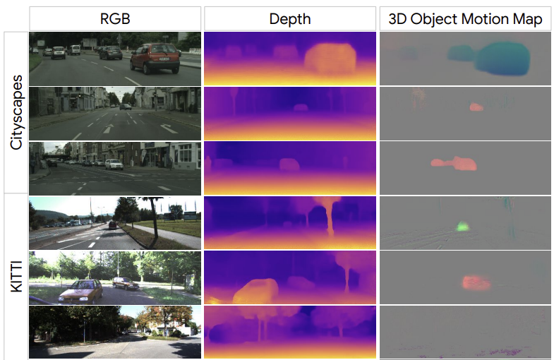
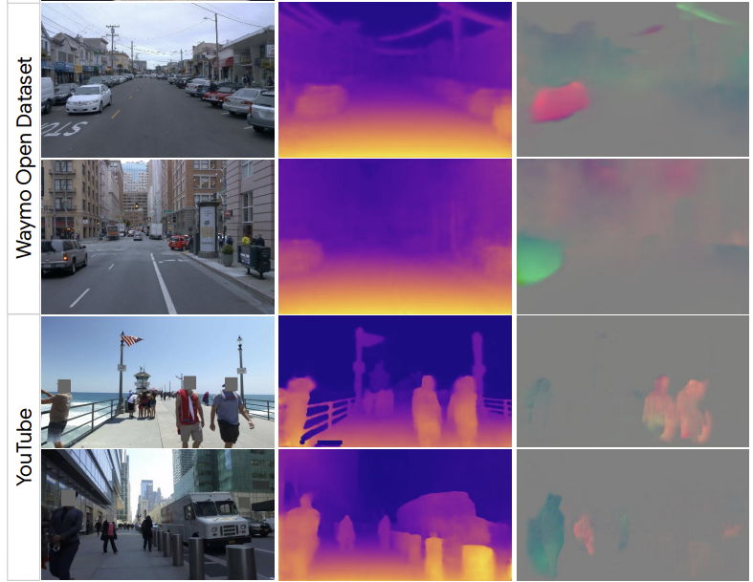
Li, Hanhan, et al. "Unsupervised monocular depth learning in dynamic scenes." arXiv preprint arXiv:2010.16404 (2020).
Introduction
> Cityscapes, KITTI, Waymo, YouTube
> Qualitative results – depth & 3D object motion map
Not need to segment out objects (motion 추정위해)
Not assume stereo data
Directly regularizes motion in 3D → 정확도 향상

Slide 10
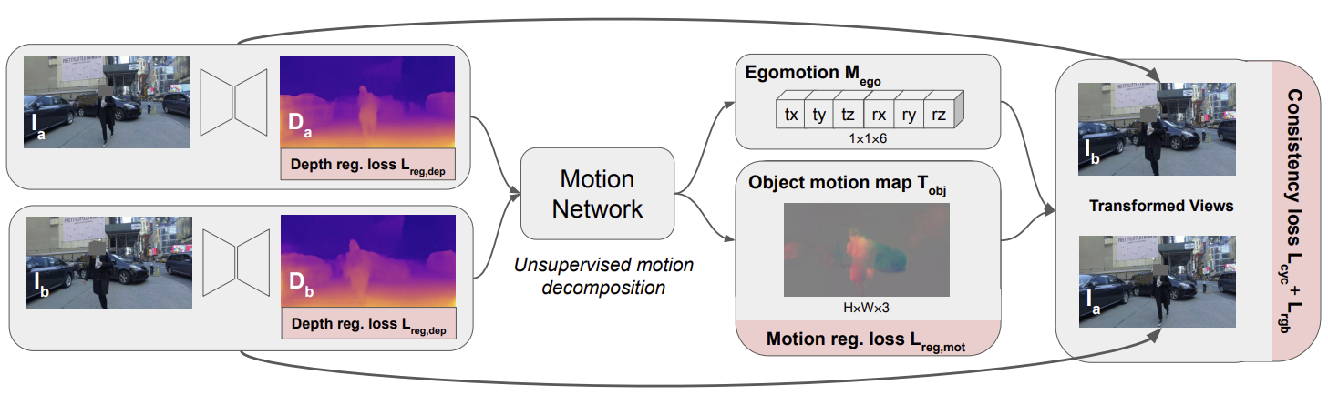
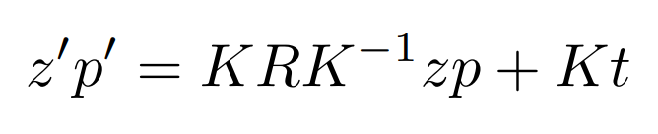
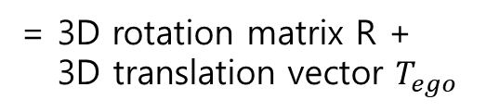
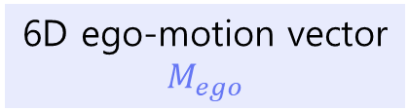
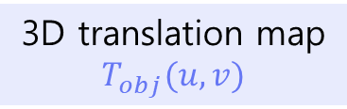
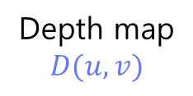
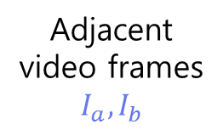
Unsupervised Monocular Depth Learning in Dynamic Scenes
Networks + Loss
Adjacent video frames
$$I_{a}, I_{b}$$
+
Depth map
$$D(u,v)$$
6D ego-motion vector
$$M_{ego}$$
= 3D rotation matrix R +
3D translation vector $T_{ego}$
Input :
1개 이미지
Depth network
Motion network
Encoder-decoder network (Randomized layer normalization)
3D translation map
$$T_{obj}(u,v)$$
Input(4채널) : 2개 이미지
RGB + predicted depth
Loss
Motion Regularization - smoothness/sparsity loss
Consistency Regularization
Depth Regularization
10/2

Slide 11
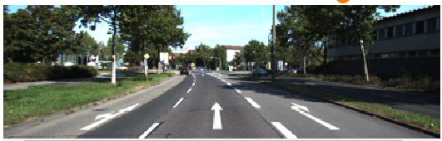
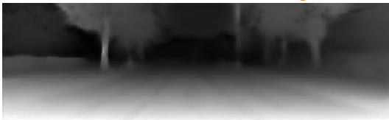
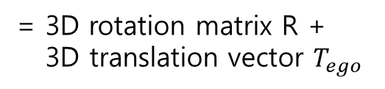
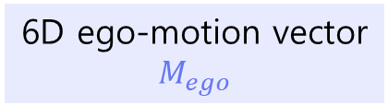
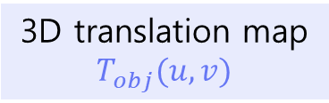
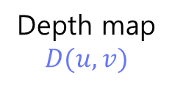
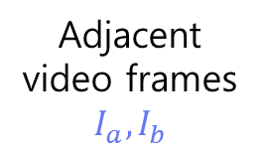
Li, Hanhan, et al. "Unsupervised monocular depth learning in dynamic scenes." arXiv preprint arXiv:2010.16404 (2020).
Method
Adjacent video frames
$$I_{a}, I_{b}$$
+
Depth map
$$D(u,v)$$
6D ego-motion vector
$$M_{ego}$$
= 3D rotation matrix R +
3D translation vector $T_{ego}$
Depth network
Input :
1개 이미지
Motion network
3D translation map
$$T_{obj}(u,v)$$
Input : 2개 이미지
RGB + predicted depth

Slide 12
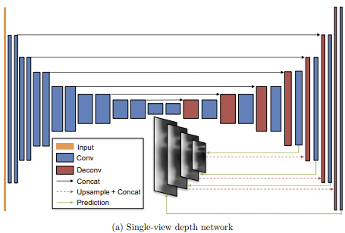
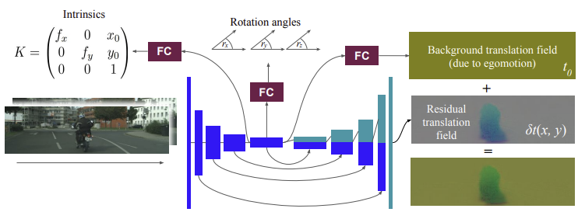
Li, Hanhan, et al. "Unsupervised monocular depth learning in dynamic scenes." arXiv preprint arXiv:2010.16404 (2020).
Method
Depth and Motion Networks
Depth network
Encoder-decoder architecture
Motion network
Input : pair of consecutive frames 연속적인 프레임
4 channels = 3 RGB + predicted depth
Ref) Zhou, Tinghui, et al
“Unsupervised Learning of Depth and Ego-Motion from Video”
Ref) Gordon, Ariel, et al. "Depth from videos in the wild: Unsupervised monocular depth learning from unknown cameras."

Slide 13
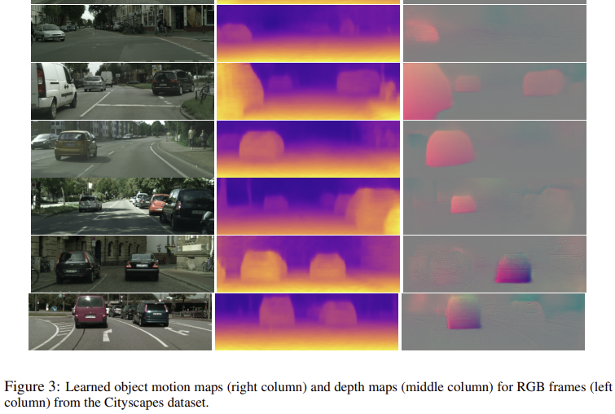
Li, Hanhan, et al. "Unsupervised monocular depth learning in dynamic scenes." arXiv preprint arXiv:2010.16404 (2020).
Experiments
Cityscapes

Slide 14
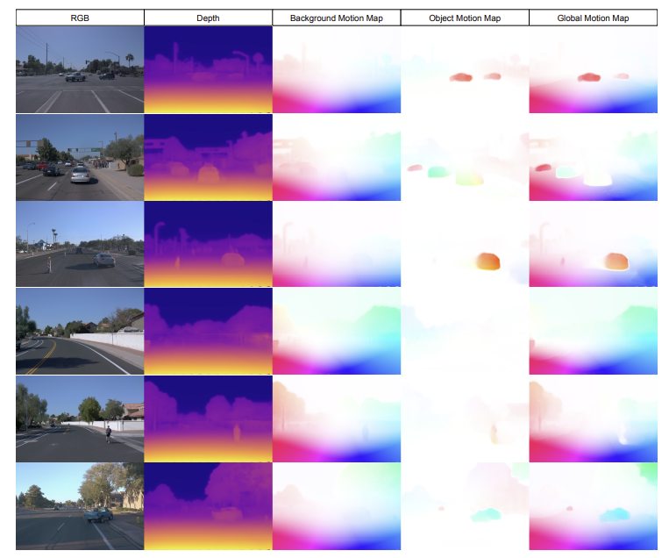
Li, Hanhan, et al. "Unsupervised monocular depth learning in dynamic scenes." arXiv preprint arXiv:2010.16404 (2020).
Experiments
Waymo Open Dataset
This figure shows RGB images, depth maps, and the 2D-appearance flows projected from 3D motion maps on the Waymo Open Dataset.
Here, we colorize based on flow direction with intensity corresponding to flow magnitude.
Using our depth and background motion estimate, we can derive 2D appearance flow of static parts of the scene (middle).
We can use the same procedure to visualize our object motion field and their global composite (right), respectively.

Slide 15
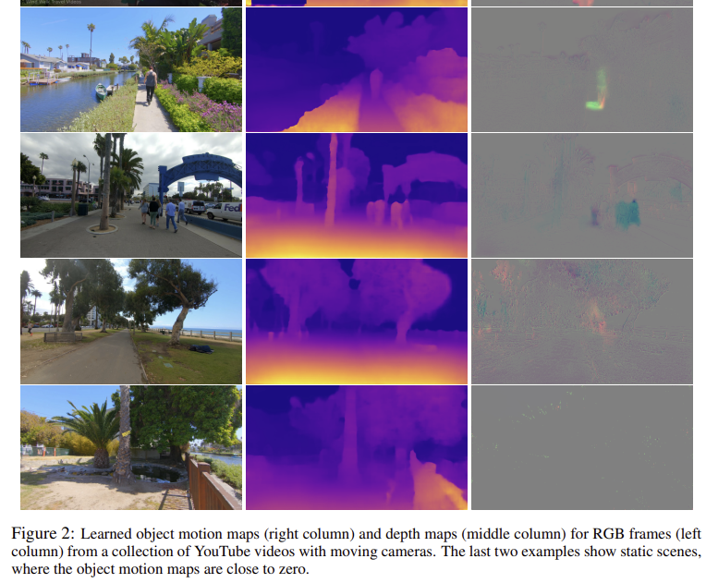
Li, Hanhan, et al. "Unsupervised monocular depth learning in dynamic scenes." arXiv preprint arXiv:2010.16404 (2020).
Experiments
YouTube videos
Hand-held monocular cameras by 다양한 환경에서 걷는 사람들
Camera intrinsics 모름
동시에 learn
4 trainable variables
2 focal lengths
2 optical centers
→ static scenes
→ static scenes

Slide 16
Li, Hanhan, et al. "Unsupervised monocular depth learning in dynamic scenes." arXiv preprint arXiv:2010.16404 (2020).
Conclusion
A novel unsupervised method for depth learning in highly dynamic scenes 동적인 장면들 depth 추정
Jointly solves for 3D motion maps and depth maps
Train – unlabeled monocular videos without requiring any auxiliary semantic information 보조 정보 없이
Use end-to-end differentiable losses - method is simple
Encourage photometric consistency, motion smoothness, motion sparsity
Limitation
Object rotation and deformation is not explicitly handled 물체 회전, 변형이 명확하게 처리되지 않음
Camera movement needs to be present to receive learning signals 카메라 움직임이 있어야 함

Slide 17
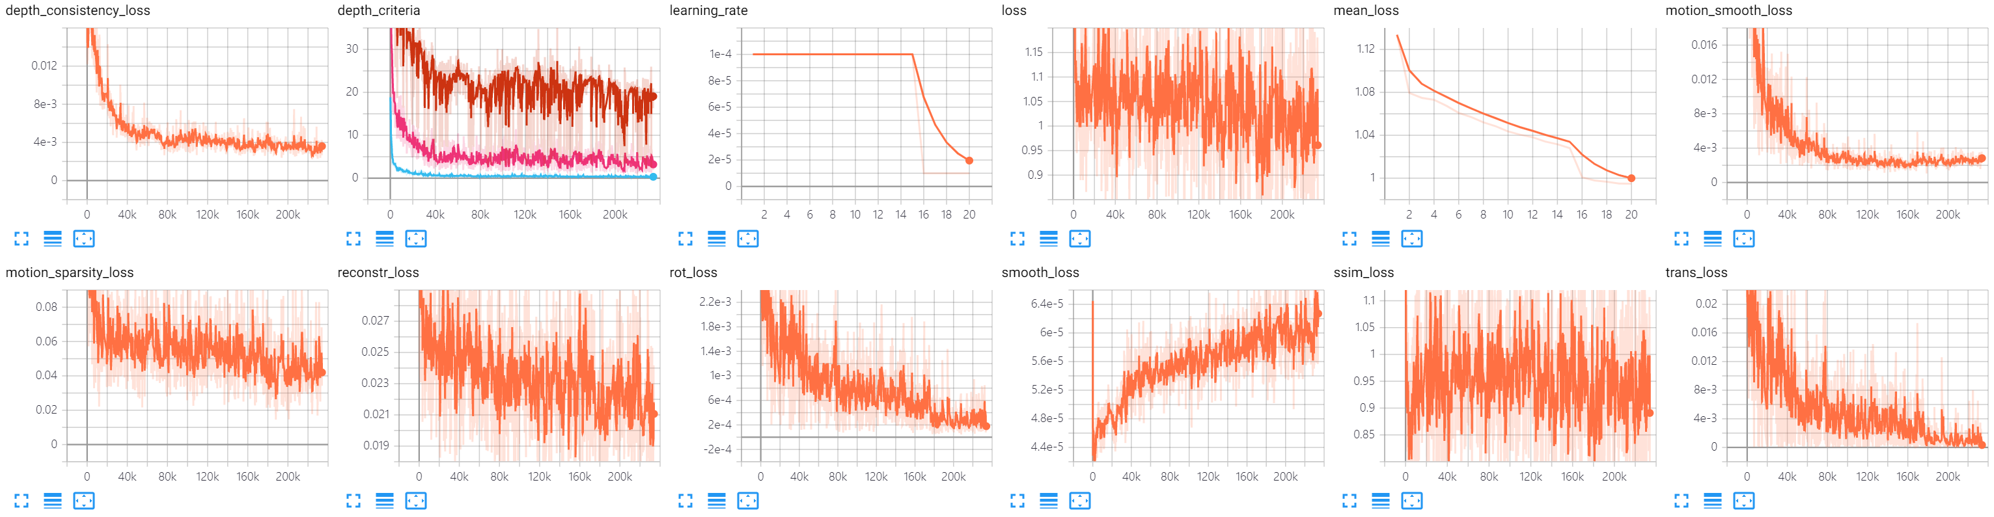
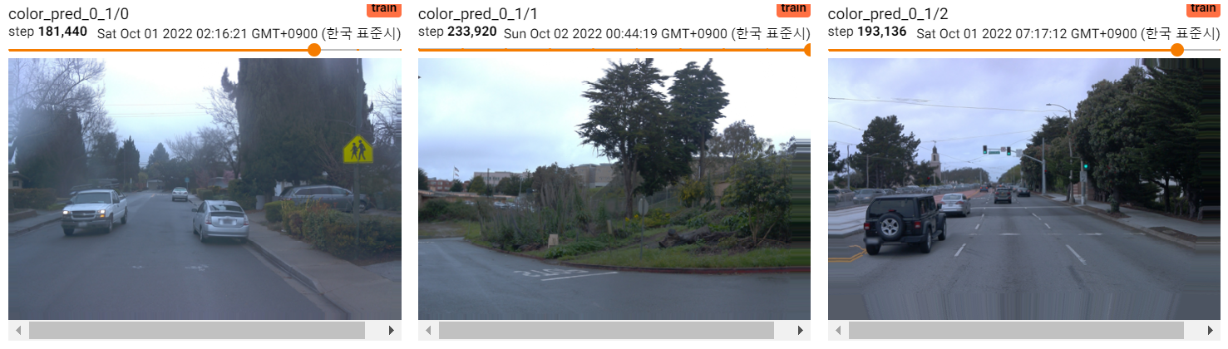
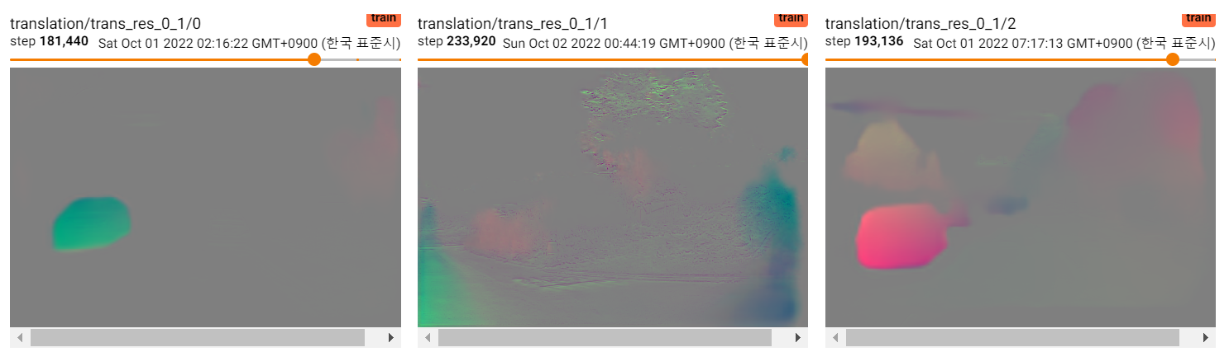
Waymo_resmof_1
Pretrained : models/waymo_ego_2/models/weights_3
motion_smooth_loss_weight = 1, motion_sparsity_loss_weight = 1
Parameter : https://docs.google.com/spreadsheets/d/1BB3DqQBbx4_BGjdJdvIbb5q0v2kMcHN_oqVGjKkAgRk/edit?usp=sharing
Notes:
https://docs.google.com/spreadsheets/d/1BB3DqQBbx4_BGjdJdvIbb5q0v2kMcHN_oqVGjKkAgRk/edit?usp=sharing

Slide 18
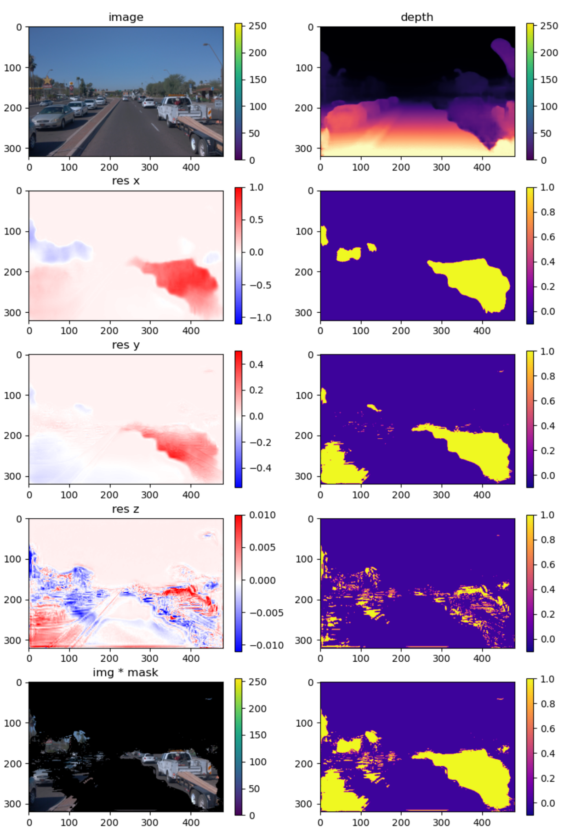
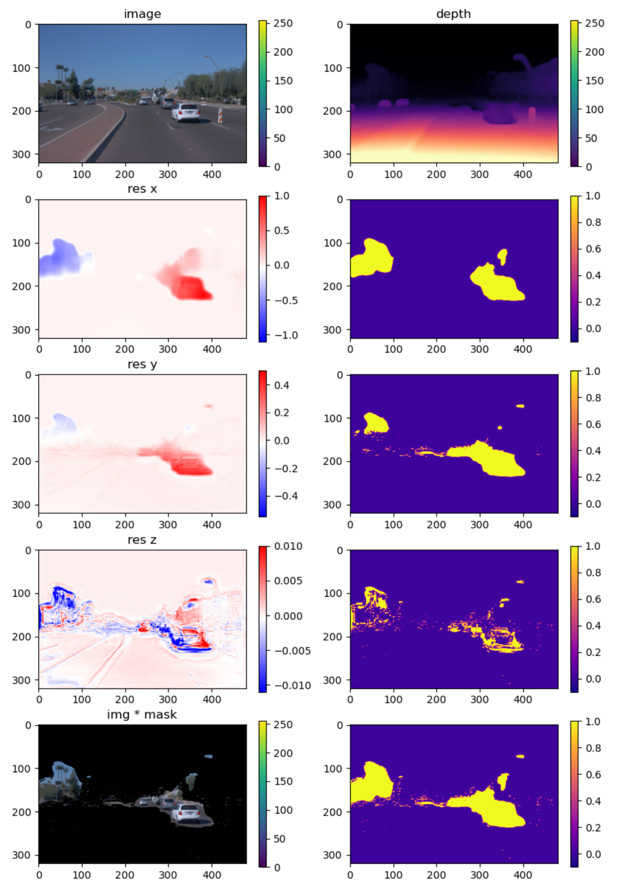
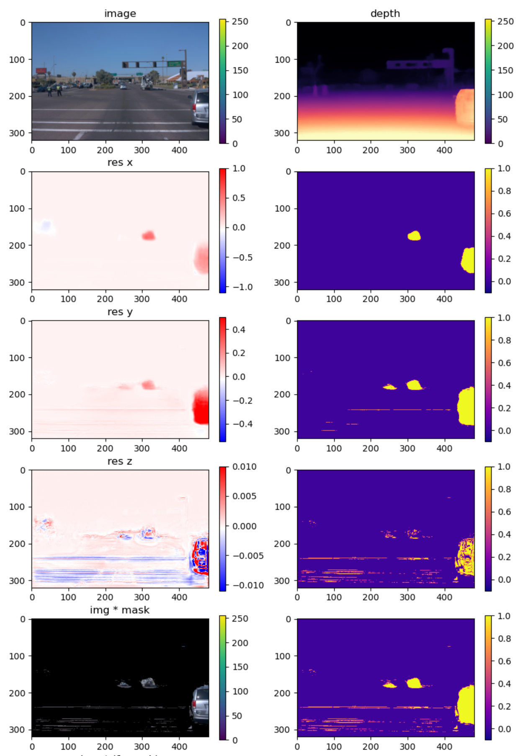
Waymo_resmof_1
MODEL=models/waymo_resmof_1/models/weights_15
DS=../waymo_gendata/training/0/0050
0000001.png
0000043.png
0000139.png
Notes:
93 / 92000

